Slide 1
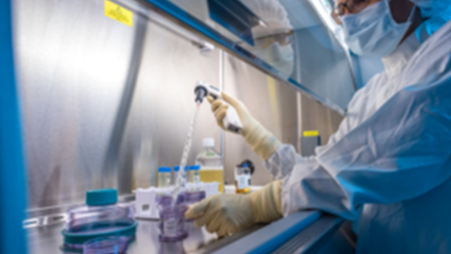
Dana Farber Cancer Institute
Connell & O’Reilly Families
Cell Manipulation Core Facility
450 Brookline Ave, Smith 11&12
Boston, Ma. 02215

Slide 2
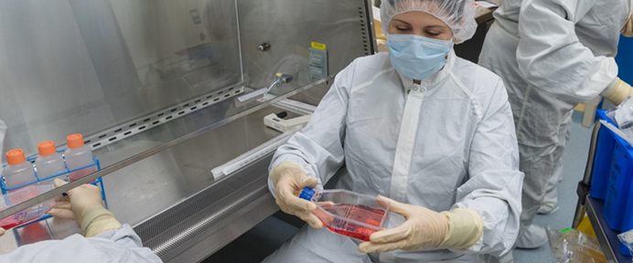
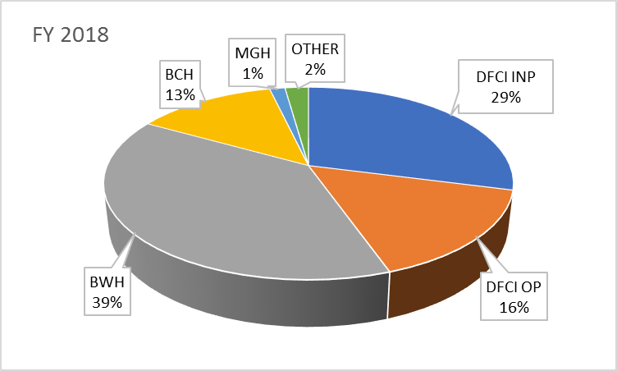
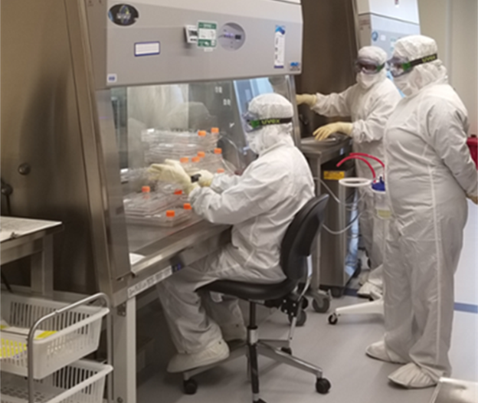
Overview of CMCF
Scope of services
  Cellular Product manufacturing for both In-patients and Out-patients for both the DF/BWH Adult and DF/BCH Pediatric programs and for other patients covered under Harvard Cancer Care (HCC) umbrella.
  CMCF is an DF/HCC Core Facility manufacturing both standard-of-care products and investigational Cell Therapy products under clinical trials
  Additional Cellular Product manufacturing to support, not only cancer trials, but also gene therapy and regenerative medicine trials
​ | CMCF -Total Products Issued (CY)​
Products​ | 2015​ | 2016​ | 2017​ | 2018​ | 2019 Proj | ​
Standard of Care Stem Cells | 1000 | 823 | 862 | 830 | 852 | ​
Bone Marrows | 102​ | 147​ | 133​ | 129​ | 102 | ​
CD34​ Selected | 8​ | 26​ | 22​ | 11​ | 12 | ​
​ | ​ | ​ | ​ | ​ |  | ​
Investigational Cellular Products | 156 | 127 | 145 | 124 | 198 | ​
​ | ​ | ​ | ​ | ​ |  | ​
Manufactured Off-site | 93 | 154 | 211 | 209 | 208 | ​
Provenge​ | 89​ | 105​ | 120​ | 70 | 44 | ​
CAR-T​ | ​ | 26​ | 30​ | 105​ | 134 | ​
Totals​ | 1249 | 1104 | 1218 | 1163 | 1258 | ​
Current Trial
Volume and Complexity
58 Clinical Trials
  17 INDs, IDEs
  18 INDs for Manufactured Off-site
17 Pre-IND validations
  CAR-T (3)
  T-regulatory (1)
  NK selection / activation (1)
  iPSC cell lines (2)
Locations for Products Administered

Slide 4
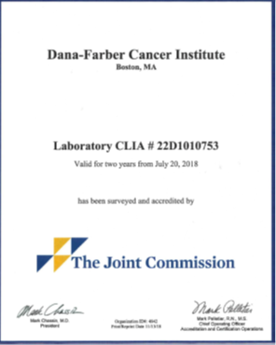
Licenses, Accreditations and Registrations
  The cell processing and quality control testing labs are inspected and accredited by The Joint Commission for our CLIA license and by FACT for both minimally manipulated and more than minimally manipulated cell therapy products as well as for immune effector cellular product
  The CMCF has been inspected by the Massachusetts Department of Public Health for both CLIA and operation of a clean rooms under USP 797 guidance
  The department is registered with the FDA (FEI: 3003934255) for the manufacturing (package, process, storage, labeling and distribution) of HCT/P 1271 products

Slide 5
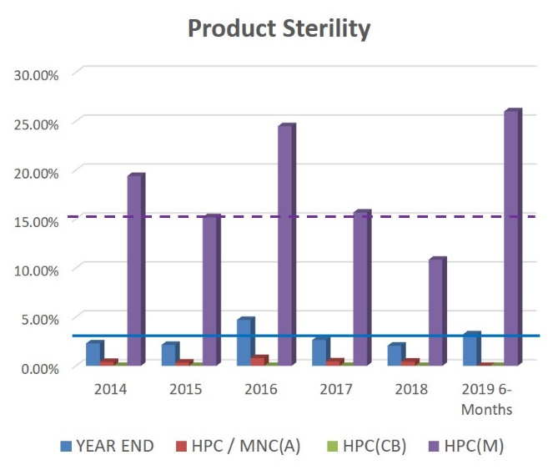
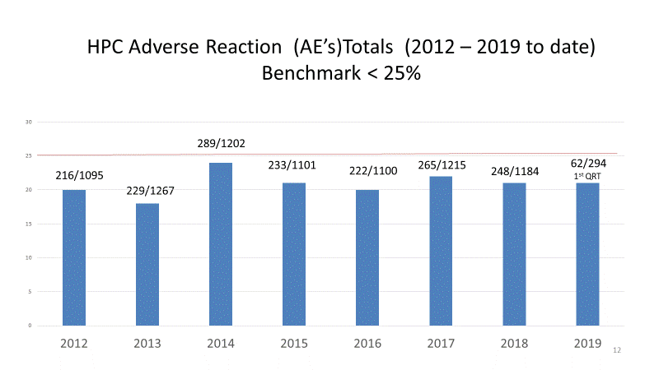
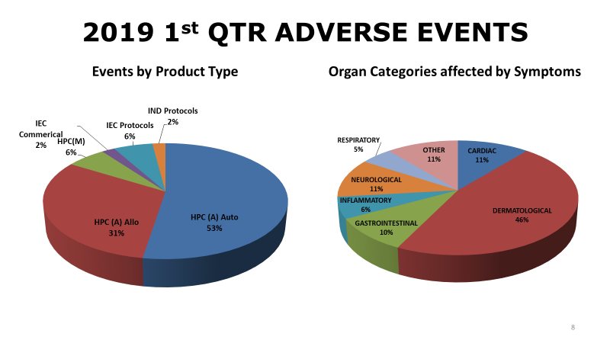
Key Quality Metrics
Product Quality
  Product purity, potency, characterization
    Sterility - ≤3% positive products for incoming products
    Viability - ≥ 70% post thaw
    Product counts - ≥ 70% recovery post processing
    Test turn around time PBCD34 ≤2Hours from receipt
Patient Outcomes
  Adverse Events (expected and Unexpected)
  Engraftment
Facility & Equipment compliance
  On-going ISO-5/7 classification
  On-going equipment calibrations, quality control, PMs
  Staff assessments with aseptic processing
Staff Training and On-going Assessments
  Initial and Ongoing documentation
  Competency / performance assessments
  Aseptic processing and EM assessments
Notes:
How often reviewed and what impact. Actual vs potential harm and how communicated to clinical team.
Sterility needs horizontal axis label and be ready to explain marrows >15% - can highlight how informed donor services QA product. And I thought marrows were <25%.
Recent review of “expected” viabilities
For adverse reactions comment on availability of Med Director, process for working up and minimal clinically significant.
Expected vs unexpected

Slide 6
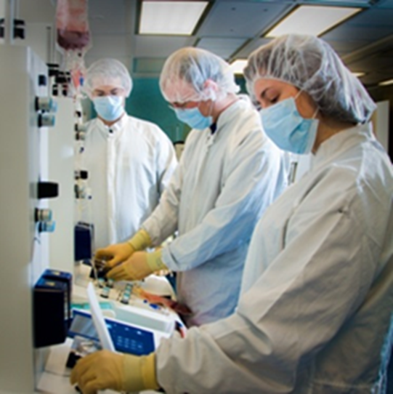
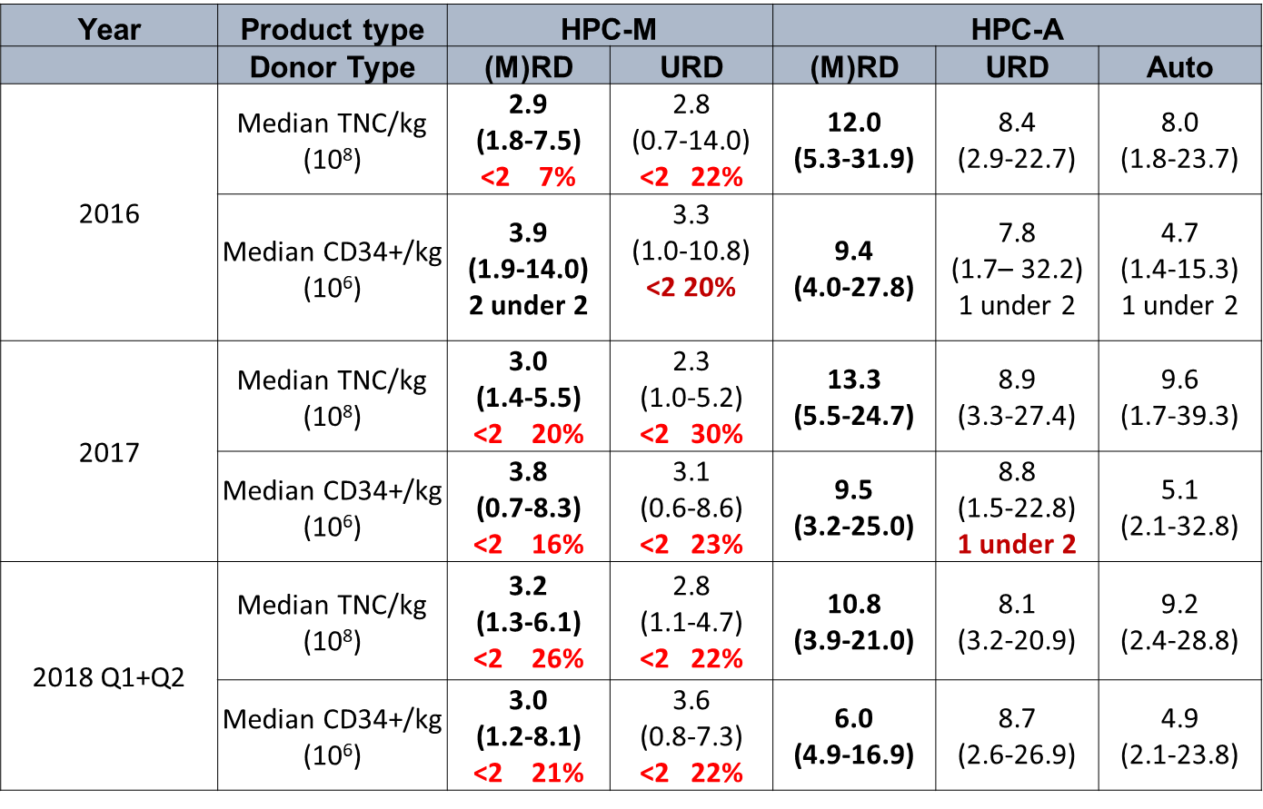
Cell Dose for HPC-M and HPC-A

Slide 7
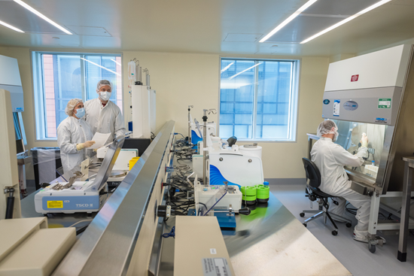
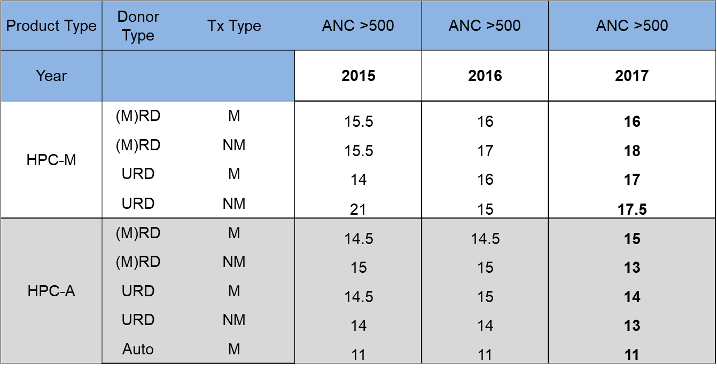
Median Time to Engraftment

Slide 8

Quality Initiative #1 –
Changes to Autologous Collection Targets Multiple Myeloma
Continuous Quality Improvement:
Meeting the increasing demand for apheresis and CMCF resources while improving safety and access for patients
Team Participants: Sarah Nikiforow, Sara Close, Justin Solle, Cell Therapy VP, Cell Therapy QA, CMCF, Kraft Apheresis, Myeloma MDs & nursing
Goal: feasibility of reducing and standardizing autologous collection targets for lymphoma and myeloma patients undergoing autologous stem cell transplant.
Previously, standardized pre-apheresis evaluation and mobilizing agents
Previously, revised collection day maxima and targets for relevant ages
Current effort, limiting collection targets for myeloma patients <65 year old to 1 “transplant” collection
Rationale: Patient safety, minimizing wait times, apheresis events, DMSO exposure and infusion reactions
Optimizing CMCF workflow and product storage requirements
Providing opportunities for future growth
Steps:
Review of clinical and resource practice patterns for the last 4 years with myeloma MDs
Proposal for safety and efficiency
Initiate practice changes and plan reevaluation

Slide 9
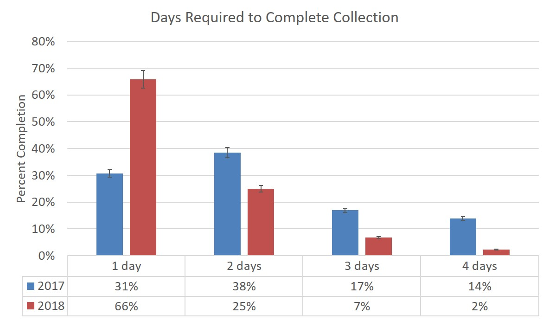
Quality Initiative #1
Changes to Autologous Collection Targets for Multiple Myeloma
Collection days:
Mean collection days decreased from 2.13 to 1.45 days =
Reduction in technician time:
Reduced processing time by 23% per myeloma patient (5.45 hours to 4.5 hours)
Storage:
Excess bags in storage decreased from 3.2 to 2.5 excess bags/patient
Collection events:
Facilitated 240% increase in CAR-T collections in this time period
Enabled totally revamping of Kraft apheresis schedule for all products
Data represents MM auto <65 yo collections, data compared between July – Dec. 2017 and between Feb – July 2018 (7 month periods)
Changes in collection target increased the percentage of autologous HPC(A) collections for MM patients under 65 completing in 1 day from 31% to 66% => improved patient safety

Slide 10
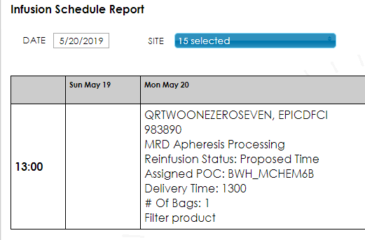
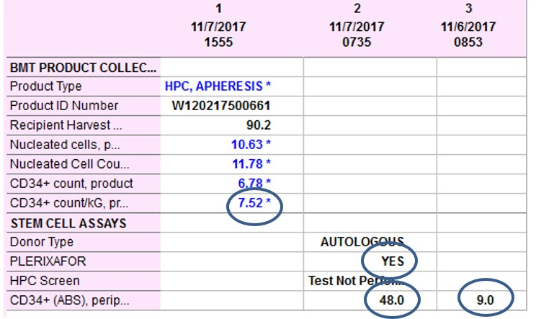
Quality Initiative #2 – Improved Communication
Problem: Scheduling with CMCF cumbersome. Product results and infusion timing not visible to MDs and nurses except via manual entries and unverified emails.
Team Participants: CMCF staff, Olive Sturtevant, Josh Geary, Eric Hubbard, Philip Brzezinski
Goal: Improve efficiency of communication and
eliminate patient delays and unnecessary meds/procedures
Steps: Eceptionist scheduling system - years
EPIC reporting modification - months
Email distribution lists – weeks
Results:
Automated scheduling by donor services and clinical trial teams
  Fewer “last minute additions” which stress system
Immediate visibility of stem cell counts
  Reduce need for extra boosting agents and collections
One verified data entry step, results sent to templated emails reaching apheresis centers (Kraft and Children’s), relevant clinicians, donor services, clinical QA all informed at once

Slide 11
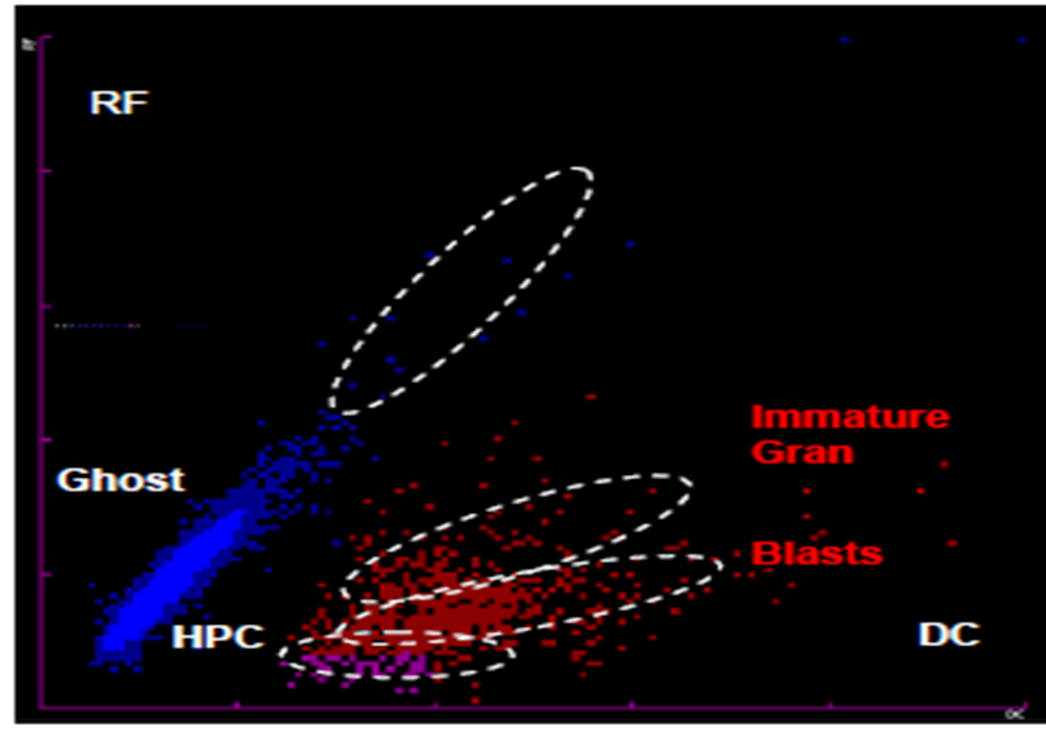
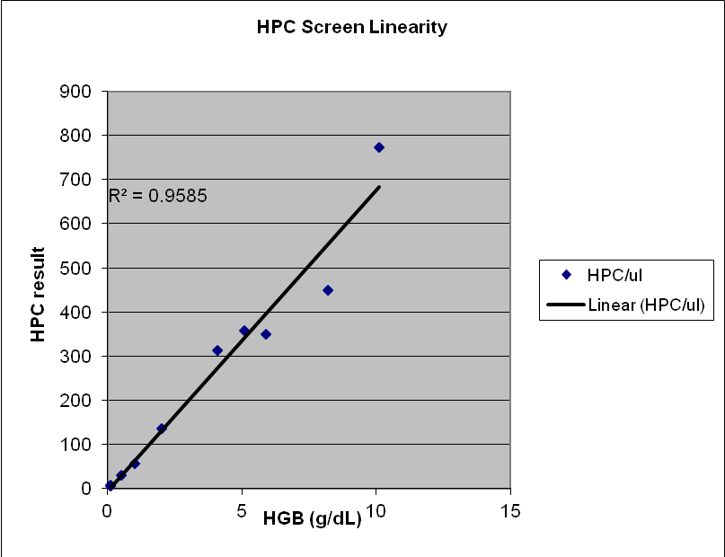
Quality Initiative #3 – Stem Cell Enumeration
Problem: >2 hour for definitive stem cell counts => patient waiting, wasted Kraft time and resources versus unnecessary collections for poor quality products
Team Participants: CMCF staff, Renee Maxwell
Goal: Implement early surrogate stem cell readout of <30 mins
Steps: Establish correlations (Sysmex vs Flow cytometry)
Ongoing analysis for congruence (multiple equip upgrades)
Results: “True” versus “False” Positives and Negatives to establish Sysmex threshold => Run now vs Wait for confirmatory Flow cytometry
●Reproducibility across low versus high stem cell concentration ●Established linearity and stability of results
Metrics met: Q1 2019 | Outcome
≥20% of records reviewed | Yes
100% of RUN results reported Correctly | Yes
100% of WAIT results reported Correctly | Yes
True Positive 64% | False Negative 12%
False Positive 0% | True Negative 24%

